Slide 1
QPower Quantum Series

Slide 2
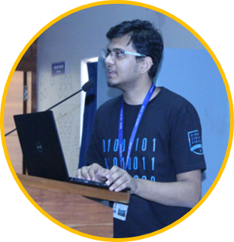
Introduction to Quantum Computing
Syed Farhan Ahmad
Microsoft Student Partner, India

Slide 3
Contents
Classical Computing
Dual Nature of Matter
Quantum Computing
3rd Industrial Revolution
Waves
Qubits
Current age
Particles
Applications

Slide 4
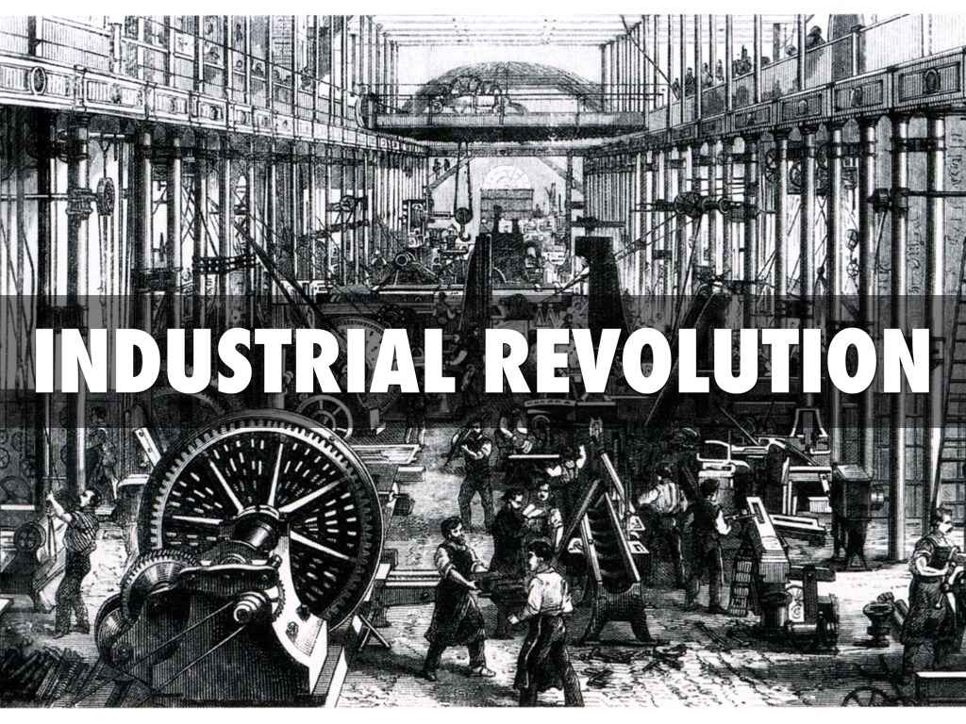
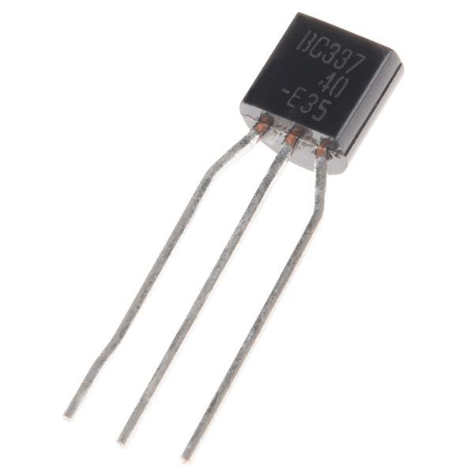
3rd Industrial Revolution
3rd Industrial Revolution

Slide 5


Switches
Transistor as a Switch

Slide 6


Understanding Classical Computers
Bits are building blocks of Classical Computers.
Programmed using Computing Languages for various purposes.
Binary Number System is used for processing and storing Bits.

Slide 7

Diving into Classical Bits
Bits are used to store information.
Classical Computers work with Bits processed by Logic Gates.
Information is processed by a sequence of Bits.
Physical Systems can be implemented into two possible states.

Slide 8

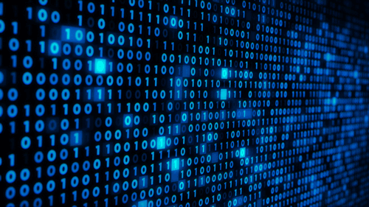
Classical Computing
Classical Computers

Slide 9

Classical Computing
End of Moore’s Law
Moore's Law states that the number of transistors on a microchip doubles about every two years, though the cost of computers is halved.

Slide 10


What is a Quantum Computer?
Two quantum states define basic unit of information processing known as Qubits.
Computes Qubits as per Quantum Algorithms.
Information is processed and stored in Quantum States of Matter.
Quantum Computing is in a phase which Classical Computing was in 1990s.

Slide 11
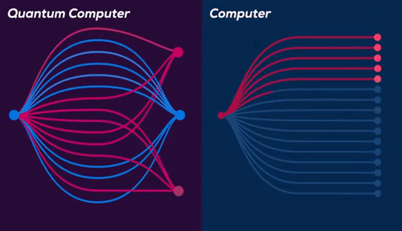
Why is a Quantum Computer better?
Parallelism

Slide 12
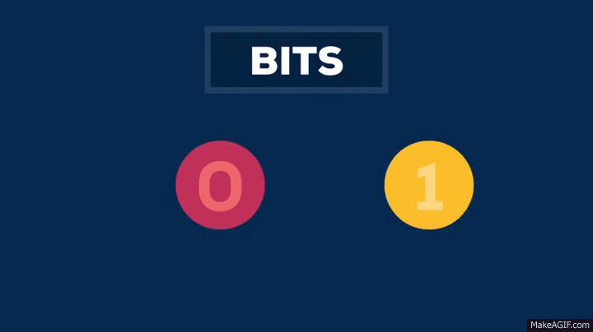
What is a Quantum Computer

Slide 13
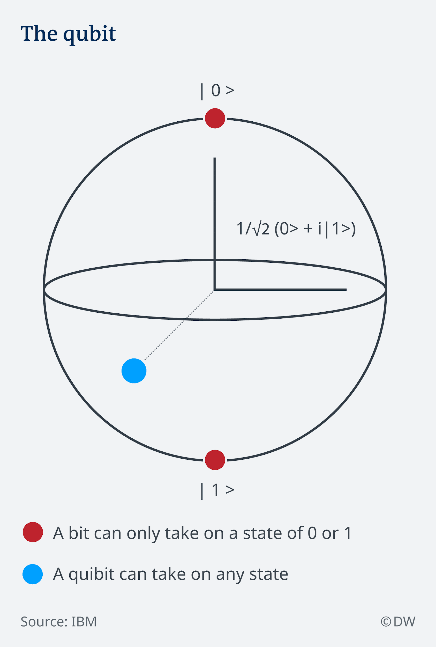
What are Qubits?
Core Component of Quantum Computing.
Exponential Amount of Information can be encoded.
A qubit is a vector of two complex numbers with unit length.
A qubit is inherently probabilistic, meaning that two identical qubits may have different values once measured.

Slide 14
Applications of Quantum Computers

Slide 15
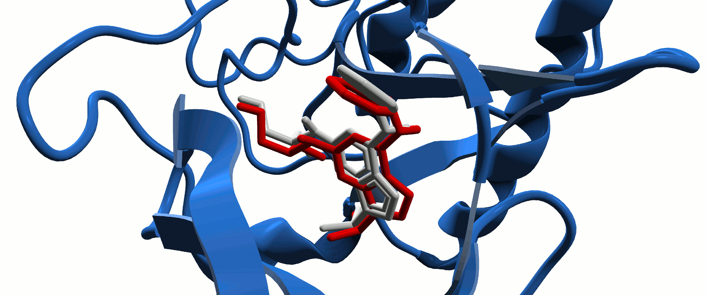
Biochemical Simulations
Molecular Dynamics
Notes:
Live example , molecular biology, etc. gif file

Slide 16
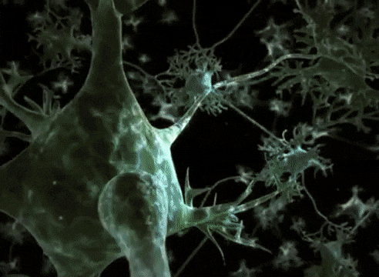
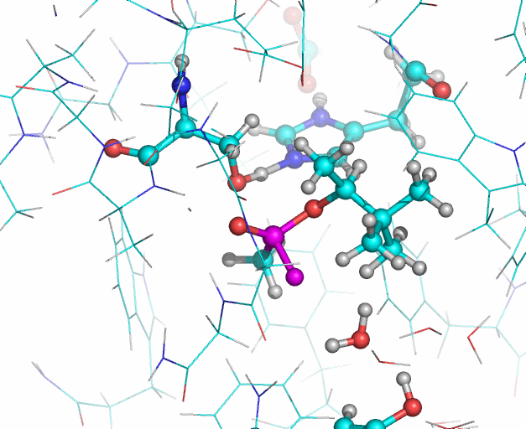
Biochemical Simulations
Human AChE enzyme
Neuron Impulse
AChE Enzyme Interactions
Notes:
Live example , molecular biology, etc. gif file

Slide 17
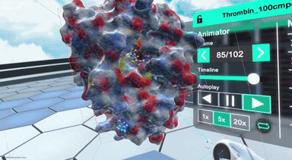
Biochemical Simulations
Drug Discovery- COVID-19??
Nanome’s VR Simulations
Notes:
Live example , molecular biology, etc. gif file

Slide 18
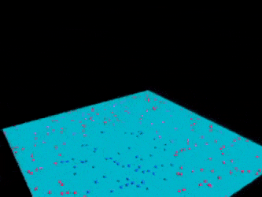
Machine Learning
Machine Learning- SVM
Notes:
Live example , molecular biology, etc. gif file

Slide 19
Dual Nature of Matter

Slide 20
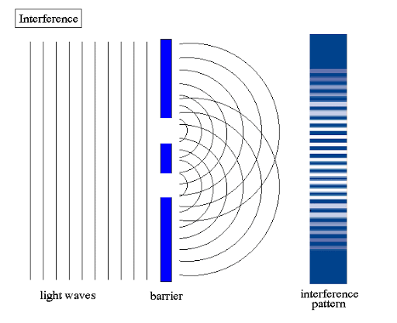
Dual Nature of Matter
Dual Nature of Matter lays the concept of Wave-Particle Duality.
Every Quantum Entity can be either a Particle or a Wave.
Double Slit Experiment explains that Light Particles can be either a Wave or a Particle.

Slide 21
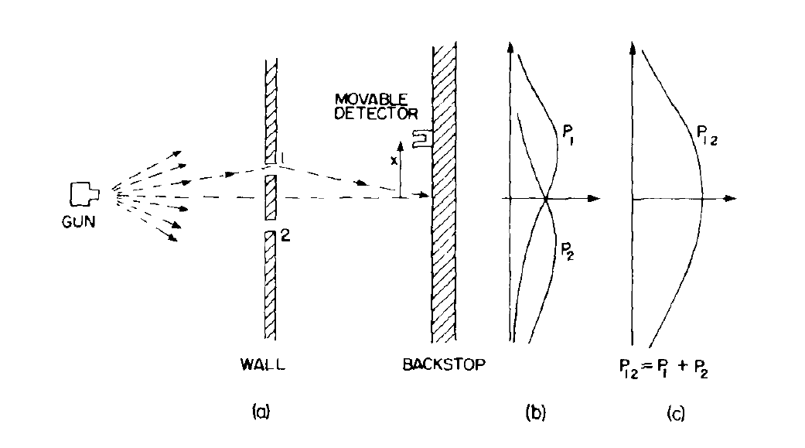
Double Slit Experiment: Case 1
Double Slit Experiment – Particle Nature

Slide 22
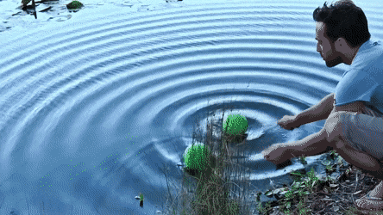
Wave Generator

Slide 23
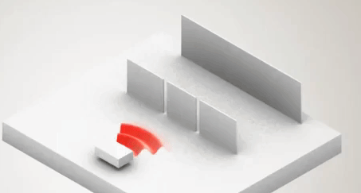
Wave Nature

Slide 24
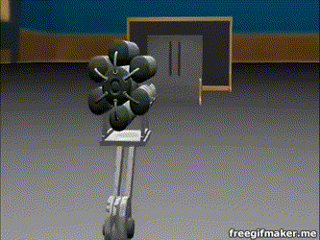
Dual Nature of Matter- electron

Slide 25

What is Third Industrial Revolution?
Proposed by American economist and social theorist Jeremy Rifkin.
Stresses over Renewable Sources of Energy as a medium to a nation’s progress.
Rides on Internet of Things and concepts of Artificial Intelligence.
Transparent and Distributed System.

Slide 26
Need for a Quantum Computer and how they Work?

Slide 27
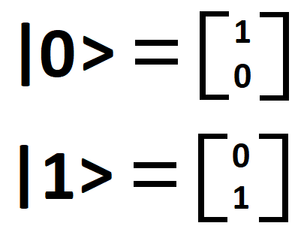
Need for a Quantum Computer
Artificial Intelligence and Quantum Machine Learning.
Cryptography.
Financial and Business Modelling.
Weather Forecasting.
Particle Physics.
Healthcare.

Slide 28
Quantum Supremacy and Dual Nature

Slide 29
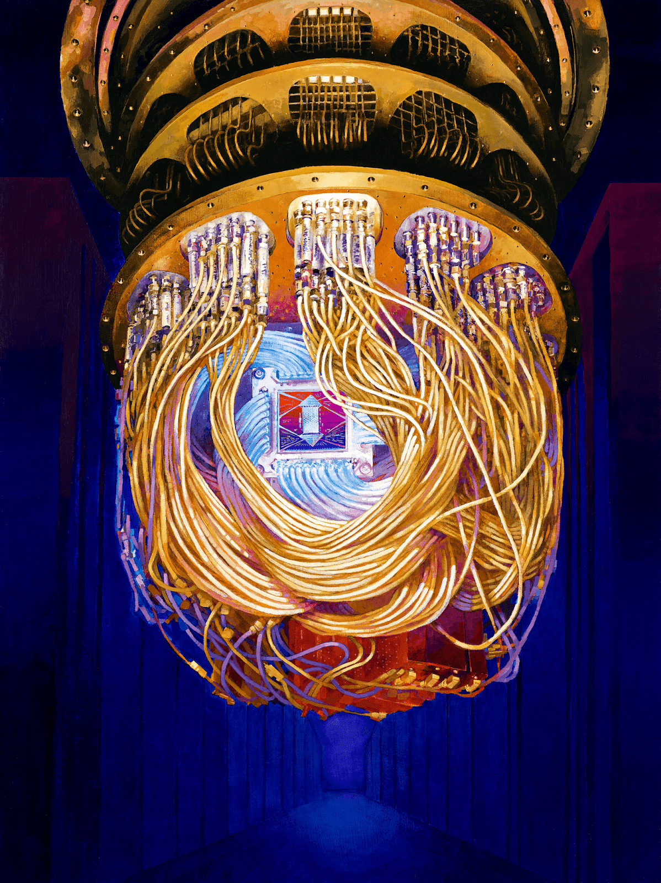
What is Quantum Supremacy?
When a quantum computer finally does something that a classical computer cannot.
Google built a 53-qubit Quantum Computer called Sycamore which can solve a contrived problem in a fraction of second, meaning that for some tasks it can outperform the world's fastest supercomputer, IBM's Summit

Slide 30
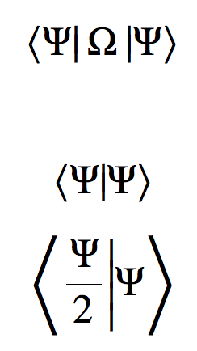
What is Dirac Notation?
Dirac Notation defines two vectors: Bra and Ket Vector.
If ψ is a column vector then we can write it in Dirac notation as | ψ ⟩ , where the | ⋅ ⟩ denotes that it is a ket vector.
Row vector ψ † is henceforth expressed as ⟨ ψ | .

